Slide 1


Android Lecture #10
Graphic, Thread

Slide 2


Index
Graphic
Example (MoveingBall)
Thread
Example (Thread)
Pingpong

Slide 3
1. Graphic
Graphic processing
Two dimension graphic
Define graphic or animation in layout.
2. Android system takes charge part of drawing .
Draw code directly by using code on the canvas.
Using SurfaceView and Thread
Draw graphic on same UI Activity and Thread
Draw graphic on other SurfaceView and Thread

Slide 4
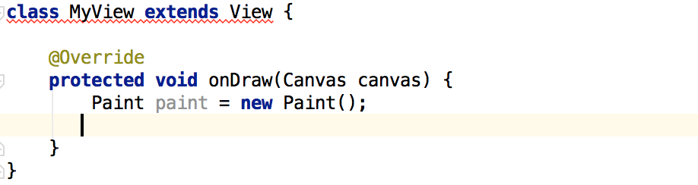
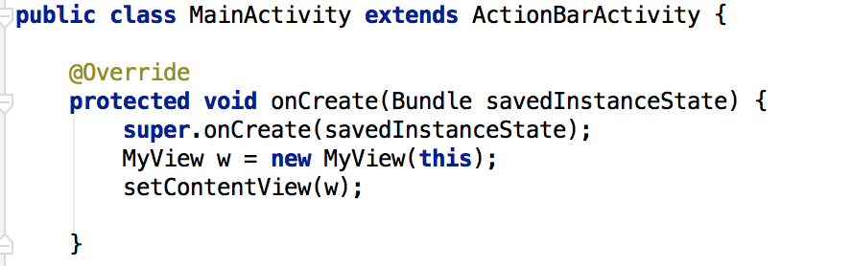
1. Graphic
CustomView
CustomView
Make CustomView
Override onDraw() method

Slide 5
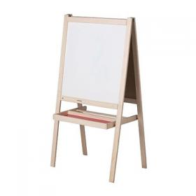

1. Graphic
Canvas, Paint
Canvas
Method that can draw figure, image, text
Paint
Attribute painting ( color, textstyle..)

Slide 6
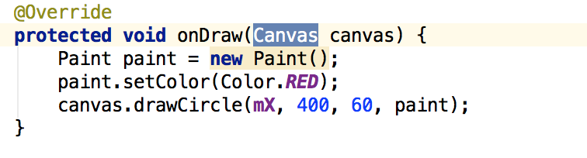
1. Graphic
Canvas, Paint
Canvas
Paint

Slide 7
1. Graphic
Canvas, Paint Function
void drawPoint(x, y, paint) : (x,y) 좌표에 점을 찍는다.
void drawLine(startX, startY, stopX, stopY, paint) : (x,y) 좌표부터 (x,y) 좌표에 선을 그린다.
void drawCircle(x, y, radius, paint) : (x,y) 좌표에 반지름(radius)만큼 원을 그린다.
void drawRect(left, top, right, bottom) : (left, top)와 (right, bottom)의 대각선을 기초로 사각형을 그린다.
void drawText(text, x, y, paint) : (x,y) 좌표에 문자를 출력한다.
void Paint.setColor(int color) : 그리기 색상
void drawARGB(a, r, g, b) : 기존 색상에 alpha가 추가된 것. (투명 : 0xff / 불투명 : 0x00)
void drawRGB(r, g, b) : 0~255까지 각 색상의 코드를 적으면 됨.
void drawColor(int color) : RED, BLUE 등 원하는 색상을 적으면 된다.
void drawPaint(paint) : 설정 값을 적용, 단순한 채우기
void drawRoundRect(RectF r, rx, ry, paint)
rx & ry : 모서리의 둥근 정도. 가상의 타원으로 두 값이 클수록 모서리가 둥글다.
void drawOval(RectF r, paint) : Oval은 달걀모양, 지정한 사각형 영역에 내접한 원을 그린다.
void drawArc(RectF r, startAngle, sweepAngle, boolean useCenter, paint)

Slide 8
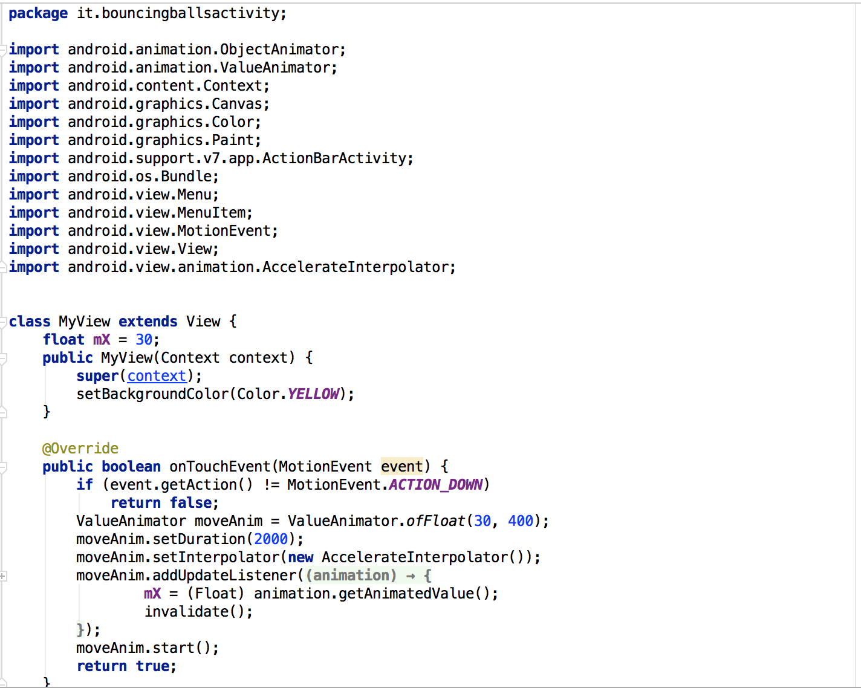
2. Example
MovingBall (MainActivity.java)

Slide 9
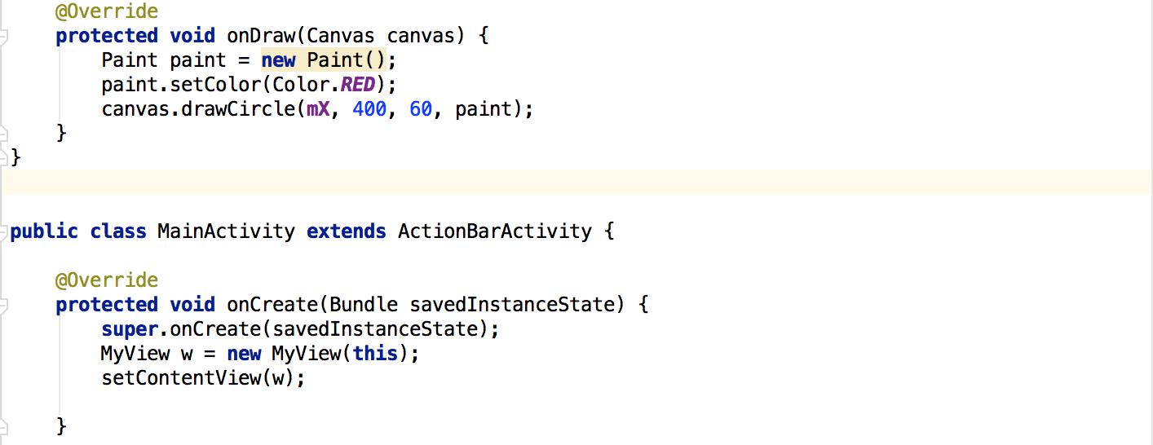
2. Example
MobingBall (MainActivity.java)

Slide 10
3. Thread
Running Unit
Process
Process have own data
Thread
Thread share same data
Main Thread
(UI Thread)
Running thread for driving application
Send event and
draw screen
Worker thread

Slide 11
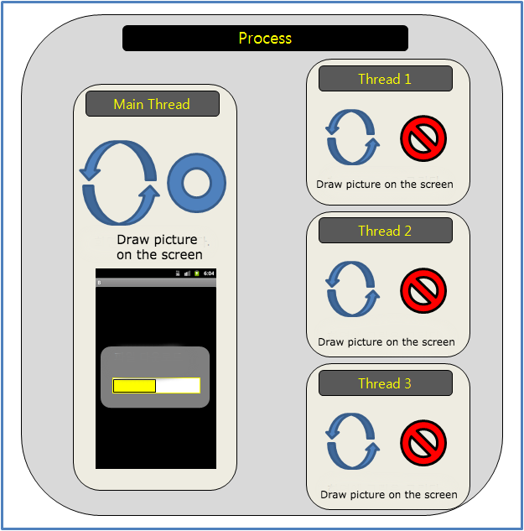
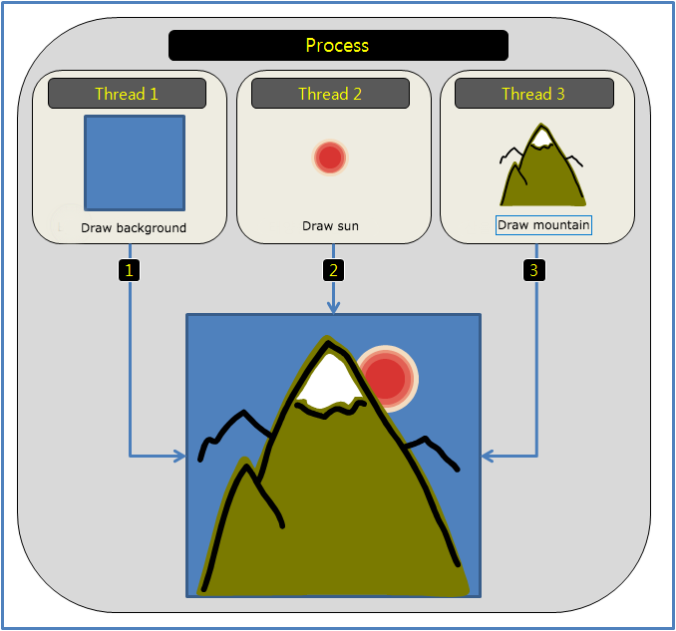
3. Thread
Process, Thread

Slide 12
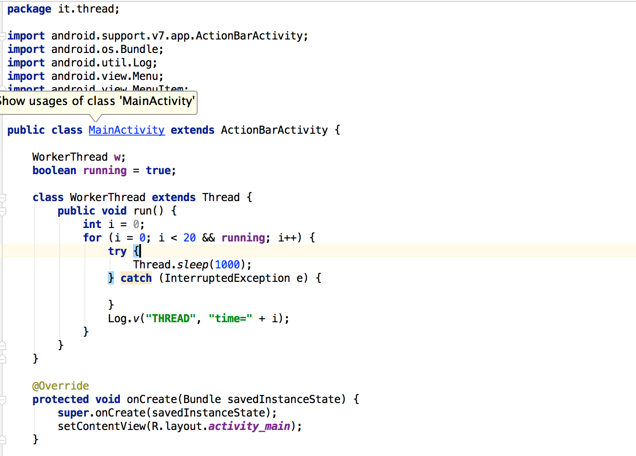
4. Example
Thread (MainActivity.java)

Slide 13
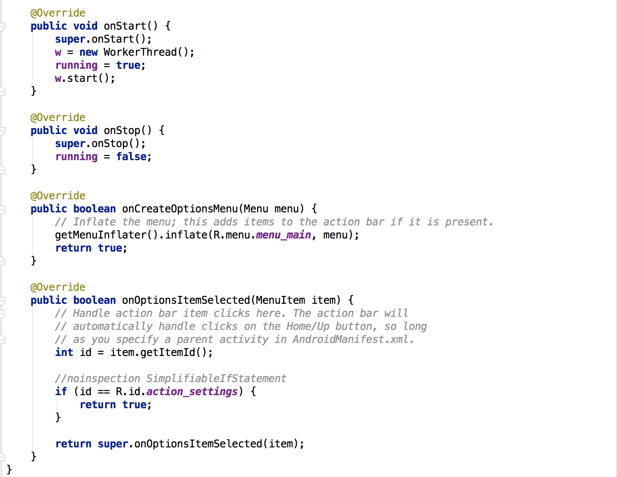
4. Example
Thread (MainActivity.java)

Slide 14
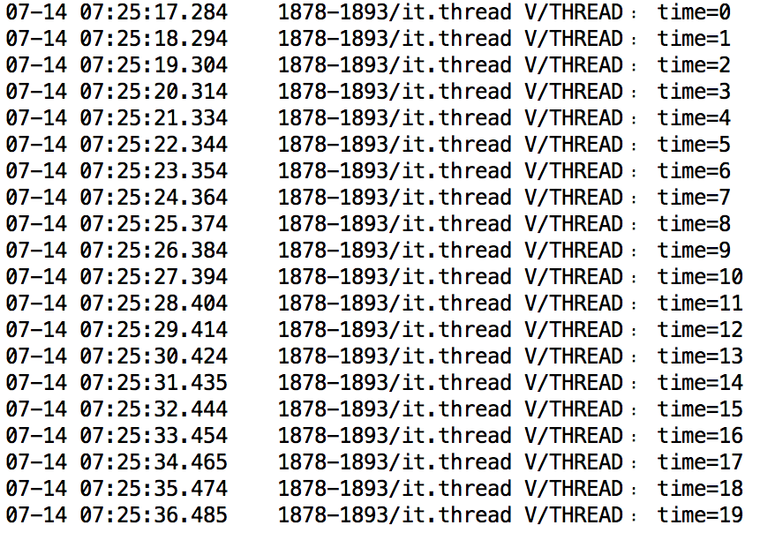
4. Example
Running Screen

Slide 15
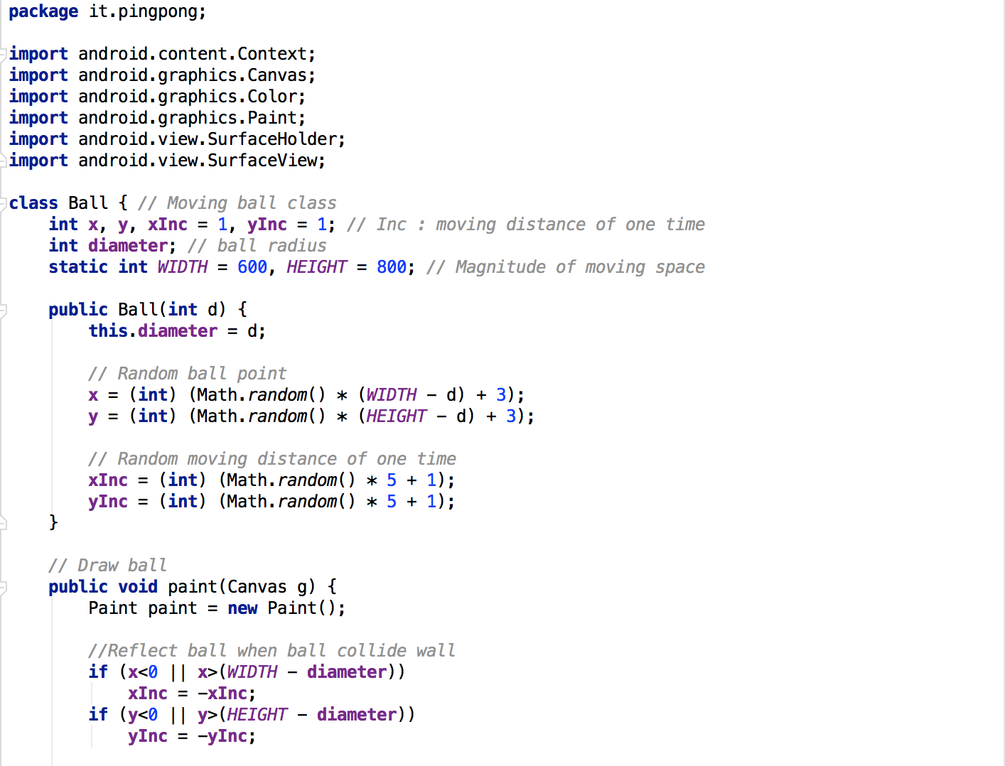
5. Pingpong
MySurfaceView.java

Slide 16
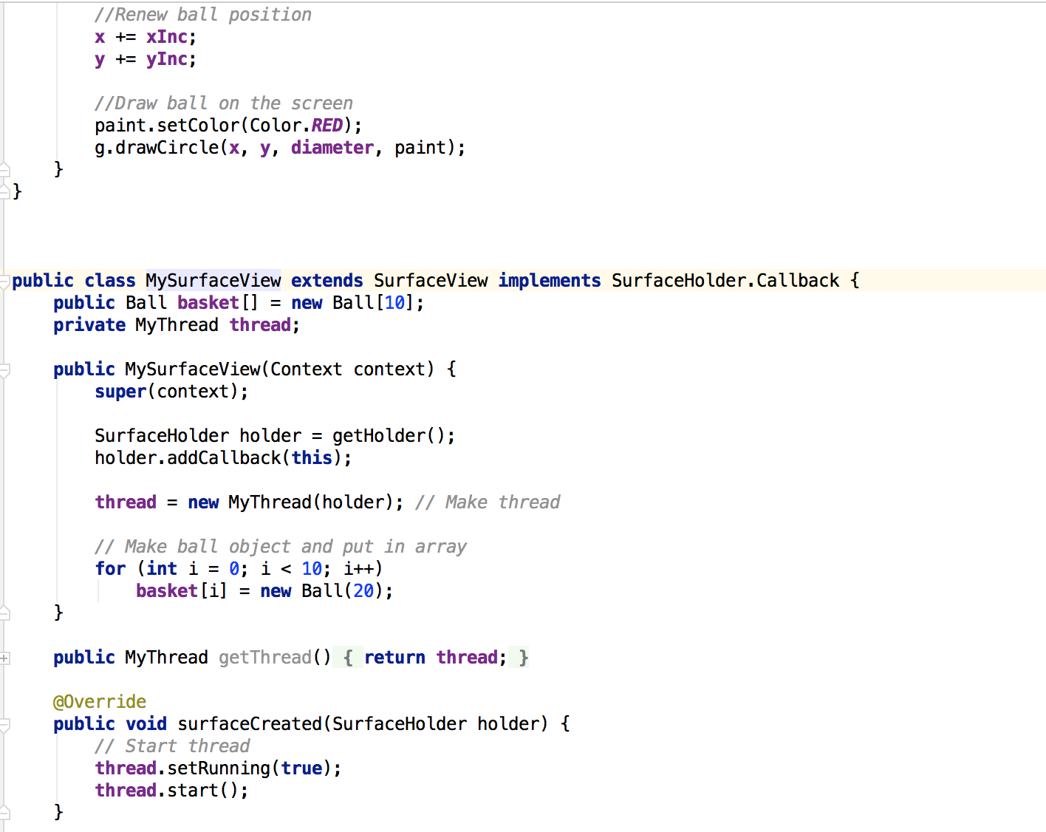
5. Pingpong
MySurfaceView.java

Slide 17
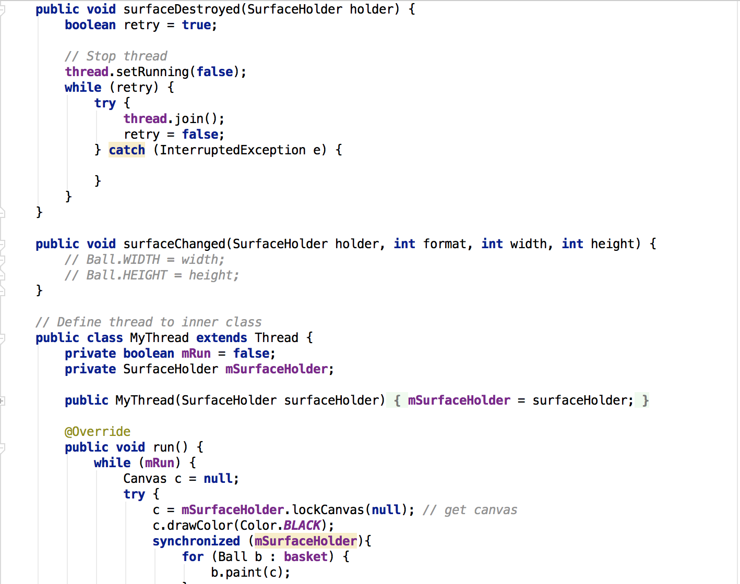
5. Pingpong
MySurfaceView.java

Slide 18
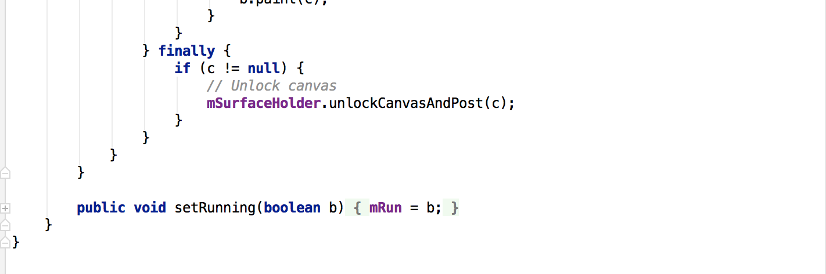
5. Pingpong
MySurfaceView.java

Slide 19
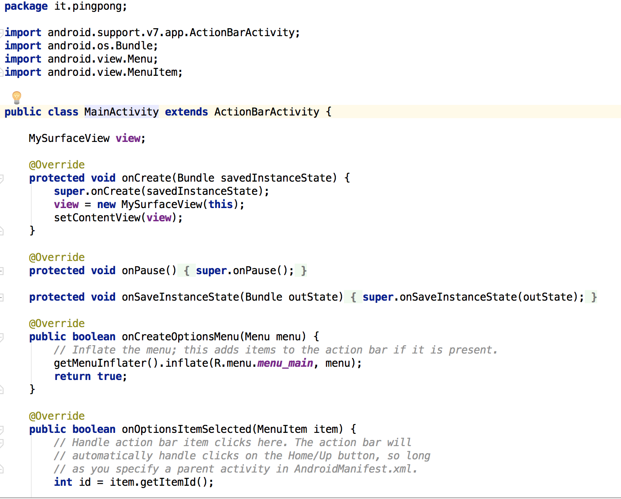
5. Pingpong
MainActivity.java

Slide 20
Thank you!

